Slide 1



Trends in Computer Science
(4COSC003W)
How to build your skills, experience and CVs
Iram Sial
Careers Consultant
Careers & Employability Service i.sial@westminster.ac.uk

Slide 2
Session Aims and Learning
Outcomes
Identify the different Careers and University services available
Learn the skills and attributes IT employers seek
Establish which mind type (skill) you are via a quiz
Understand how to increase your skills and experience
Understand the basics of creating a CV and learn about the two different formats to use
Familiarise yourself with STAR and applications
List 2-3 action points for your skills development

Slide 3
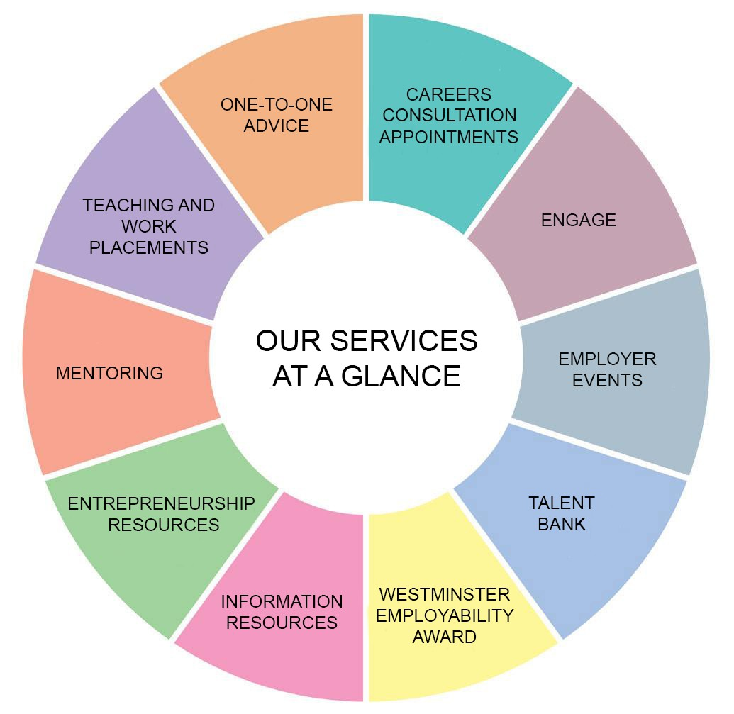
CAREERS AND EMPLOYABILITY SERVICE

Slide 4
1-2-1 ADVICE & GUIDANCE
Career Choice
Skills Assessment
Action Planning
Job seeking
Part-time, Placements & Graduate jobs
Entrepreneurship
Mock Interviews
Psychometric Testing &
Assessment Centre Advice
Applications & online presence
Jobs and further study

Slide 5
THINGS TO FOCUS ON THIS YEAR
Part-time work
Placements & Internships
Insight Programmes
Careers Fairs & Events
Mentoring
For more info contact our
Work Experience and Placement Teams

Slide 6
Employers’ Expectations of Graduates
– “Increasingly these days, a degree alone is not enough. In today's highly competitive job market it is crucial that students make themselves as employable as possible through a combination of both academic and softer skills.”
Carl Gilleard – Former CEO Association of Graduate Recruiters
– Degree + Experience + Skills
employers expecting?
….. What skills are Tech

Slide 7
Technical/programming/Systems knowledge: Java, Python, JavaScript, C, C++, VB, Matlab, Ruby, Scala, Digital Design (hardware)
Soft/Transferable Skills and Attributes:
Planning & Organisation
Drive, Motivation, Enthusiasm, Confidence
Problem solving, Initiative
Communication, interpersonal and presentation
Teamwork/collaboration/can do attitude
The ‘right fit’ – Are you right for that organisation/its culture – will you fit into the team there?

Slide 8
Excellent Resources
Targetjobs.co.uk – IT and Technology
-Advice, Articles, Internships, Sector Info,
Prospects.ac.uk – IT and Computer Science
-Sector overview, Job Profiles, Types of jobs in IT, Vacancies, Information, Advice
Gradcracker.co.uk
Ratemyplacement.co.uk

Slide 9

Powerful Minds Test – Activity 1 (3mins)
https://www.accenture.com/gb-en/careers/powerful-minds
Which Mind type are you?
Collaborative, Adaptive, Analytical, Active
Powerful Minds Video

Slide 10
Employers’ three questions
Can you do the job?
Do you have the required knowledge and skills?
Do you want the job?
Do you have the motivation?
Will you fit in?
Do you have the relevant values and qualities?

Slide 11
STEPS TO TAKE:
1.Learn to code – outside of your degree
Work experience, volunteering (e.g.in a local school running coding classes)
Working on personal project such as an app or website, online communities
Contributing to open-source projects, hackathons or coding competitions.
Keep up to date with new technologies, and understand how they will impact the world around you.
Insight Programmes/ Summer Internships/ Placement Years/Part time jobs
Build on Soft Skills : SKILLS THAT AREN’T TECHNICAL!
Technology recruiters look for creativity
The ability to be self-critical
Collaborating with colleagues or gathering a specification from clients
Willing to help colleagues get their jobs done
How you relate to other people
Source: Targetjobs.co.uk

Slide 12
Where to build skills & experience:
Course work, presentations, group work, reports
Tech Communities (GitHub, Stack Overflow)
Tech Competitions/Hackathons
Learning new programming language
Employability Events/Networking opportunities (alumni)
Course rep /Student Union societies/activities
Work experience & Voluntary activities
Employment /Internships/Insight Programme
Sports / hobbies / clubs
Travel

Slide 13
SOMETHING TO THINK ABOUT!
Recruiters report that students applying for graduate technology jobs are particular culprits for not taking applications and employability seriously enough.
That’s compared with students applying for other graduate roles, eg business or finance, and with those who have just left school applying for technology apprenticeship roles.
* It’s time to take action and turn yourself into your recruiters’ ideal candidate. (Unemployment rates)
(targetjobs.co.uk)

Slide 14
Top 10 CV mistakes
Including personal information that is unnecessary/unwise
– Date of birth, marital status, NI number, passport number, a picture of yourself
Putting too many things in bold
SPELLING ERRORS DUE TO USE OF CAPTIAL LETTRES THAT WORD DOES NOT SPELCHEEK
Spelling errors due to poor spelling or taking the fist worm first word that the spellchecker suggests
List of skills without an indication of where they came from or how well developed they are

Slide 15
Top 10 CV mistakes
Incorrect usage of apostrophe’s
Interests: “Socialising with friends” – employers hate this and they would not be your friends if you did not socialise with them
Listing ALL of your GCSEs and using up more space doing so than for the much more important degree
Using multiple fonts, colours, emphasis and
sizes throughout and inconsistently

Slide 16
Top 10 CV mistakes
10. Having a “personal” statement at the top which reads something like this:
Highly motivated enthusiastic self-starter with strong interpersonal skills capable of working independently or as part of a team.
Which describes pretty much everyone and isn’t personal at all.

Slide 17
Recipe for application success
Target your application to the particular position and organisation
Emphasise your achievements and relevant skills
Provide evidence for your skills, using powerful action words to describe what you did eg organised, initiated
Tailoring your CV

Slide 18
Action words
achieved adapted administered analysed audited budgeted calculated collaborated composed conducted contracted coordinated created demonstrated designed developed | devised discovered doubled drafted edited eliminated enforced established evaluated expanded explained forecasted formed founded generated guided | hired implemented improved launched maintained managed marketed motivated negotiated obtained operated organised planned originated performed | produced promoted provided recruited reorganised researched resolved reviewed simplified solved surveyed supervised taught tested trained

Slide 19
Target your CV
Identify what each employer wants
– job advert, employers’ websites, careers information research
Identify evidence that demonstrates you meet the employer’s criteria
Make your CV relevant, accurate and obvious

Slide 20
Supporting your CV with evidence
Use positive, powerful simple language
Reinforce the skills and achievements with examples in context.
Examples
Showed innovative approach by developing new queuing system which greatly improved efficiency and customer experience.
Demonstrated strong customer service skills as evidenced by numerous very positive mystery shopper feedback reports.
Proven ability to work well under pressure, often managing the sales desk single-handedly during busy periods.

Slide 21
CV content
– Name and contact details:
– postal address, telephone/mobile number, e-mail
Profile/Career objective
Technical skills
Education
Work and / or voluntary experience
Other skills – such as languages
Interests
References
You decide the relevant order based on what sections you feel are most important to the role and employer

Slide 22




Interests and hobbies – the 3rd dimension
Interests allow you to inject some of your personality into your CV
You are more than the sum of your qualifications and experience
Don’t just say “Cinema, Socialising, Gym”, go into some detail
Highlight skills and qualities which may impress an employer
Qualifications
Skills and Experience
Skills and Experience
Example:
Gym: Regularly attend the gym which requires strong self-motivation and self-discipline.
Travel: Enjoy taking opportunities to travel to experience different cultures and practice language skills. Recently visited China and Singapore.

Slide 23
Types of CV
Chronological CV
Another sample
Remember:
The reverse chronological cheat: Relevant experience and Other experience
Skills-based CV
Remember:
A skills-based CV won’t be effective if you are applying for a role for which you are suitably qualified and/or experienced

Slide 24
CVs - summary
Follow recruiters advice!
Choose an effective format
Use appropriate language accurately/pay attention to detail (presentation, language, spelling and grammar)
Target your CV to address the requirements of each employer
Ensure that everything you include is relevant to the role you are applying for – axe non essential
Provide evidence of your experience and skills where appropriate
Your CV should reflect you – your personal sales document

Slide 25
Be a STAR at applications and interviews!
Use the STAR format to structure your answers:
Situation
What was the context? Where were you? What were you doing?
What was your goal? What was the problem or challenge?
What action did you take? Be explicit about your role.
What was the outcome & why? Would you do it differently next time?
Task
Action
Result

Slide 26
Application form questions….
Many online applications ask competency questions, in which you need to give a real-life example of a time when you have demonstrated a particular skill or achieved something.
Examples include:
Give an example of a time when you worked as part of a team.
Give an example of a time when you brought about an improvement.
Give an example of a time when you increased profits.
Give an example of a time when you delivered outstanding customer service.
Give an example of a time when you brought someone round to your way of thinking.

Slide 27

Covering letter / email essentials…
Write to a named person or Dear Hiring Manager
Watch spelling and grammar - do not use abbreviations, email or text language
Sign off correctly – ‘yours sincerely’ for a named person or ‘yours faithfully’ for Hiring Manager, or Regards for an email
The main purpose is to get your CV read
Keep it succinct (1 page) and targeted (to the job)

Slide 28
Get the content right….
Reference / subject line
Paragraph 1 – Why are you writing
Paragraph 2 – What are you offering the employer (key points)
Paragraph 3 – What attracts you to the job role and company, - Appeal to company values, attitudes, goals, projects, etc
Paragraph 4 – End on a positive note

Slide 29

…..Why do you want to work in this role and for this company?
Show you know what is involved in the role and what the
company does (vision, mission,CSR)
Link this to things you have done and enjoyed.
Make it personal to you (vs other applicants)

Slide 30

Detailing your experience
Include specific, credible examples of your qualifications for the position.
Use numbers, names of equipment you've used, or features of a project that may apply to the job you want.
e.g. As a Customer Service Representative at Barclays, I provided quality customer service while promoting the sale of products to customers. I also handled £10,000 a day and was responsible for balancing the bank’s cash machine.

Slide 31
Skills Analysis Survey Activity 2 (5mins)
– https://www.mindtools.com/pages/article/get- started.htm

Slide 32
Action Plan (3 mins)
– List 2-3 immediate actions you will do as a result of this session to start building your skills, experience and knowledge!

Slide 33
Summary
Degree + Skills + Experience=Perfect Candidate
Many schemes/services at University/Careers
Build your skills in and outside the University
Make yourself stand out: Mentoring, Going abroad, Work Experience, Competitions, SU
CVs, Letters and Applications – be a STAR
Careers can help: 1-2-1 appointments, employer events, vacancies on engage

Slide 34


Careers & Employability Services
Engage – engage.westminster.ac.uk
Online appointments, vacancies and events system
Includes an enormous range of additional resources
on Engage Plus with lots of information and video content to help you with your career.
Information and advice on
CVs, Covering letters and application forms
CES Resource – different careers services (old video)
Resources
Guides, general and sector specific publications
Face-to-face advice and guidance – bookable via Engage
20 minute quick query session
45 minute in-depth individual guidance or mock interview session
Targetjobs.co.uk – IT and Technology
Prospects.ac.uk – IT and Computer Science

Slide 35



HOW EMPLOYABILITY IS EMBEDDED WITHIN THE CURRICULUM
Speak with your personal tutor and/or course leader to find out more!

